Slide 1

Project proposal
Network Topology
Abhishek M (200070003) Neeraj Nixon (20D070056)

Slide 2

Network Topology
Network topology is the arrangement of the elements of a communication network. Network topology can be used to define or describe the arrangement of various types of telecommunication networks.
Each node in the network topology has a certain set of parameters associated with it like Latency and Bandwidth.

Slide 3

Aim
To create a logical program which can create a network topology which minimizes the path between two given nodes.
To make a python GUI to create an interactive user interface.

Slide 4
Components involved
The clingo code which implements the required topology by connecting the nodes which minimizes the path between them.
A python code that implements the GUI interface for the program which provides the user with a better way to interact with the code

Slide 5
Input format
Number of nodes and end points between which the minimum path is to be calculated within the network topology.
The connection between the nodes within the network topology (user defined).

Slide 6
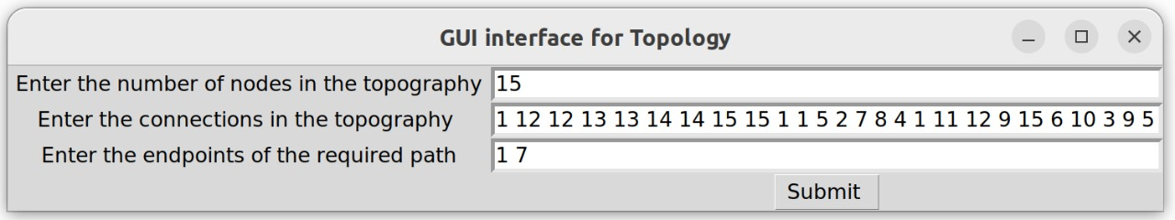
Python GUI Input Format

Slide 7
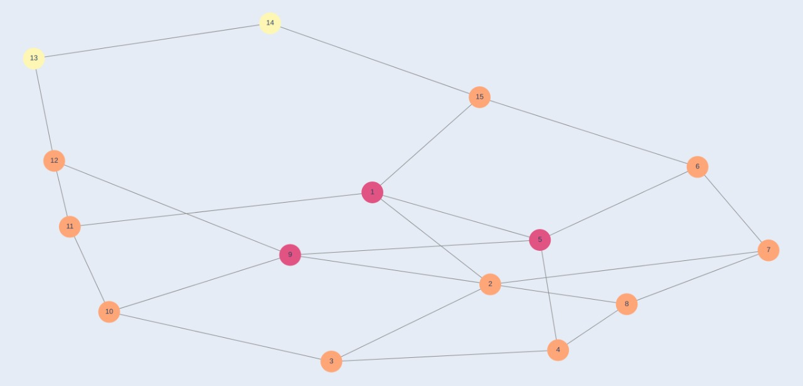
Output format
Outputs the network topology created by the user with all nodes and connections.

Slide 8
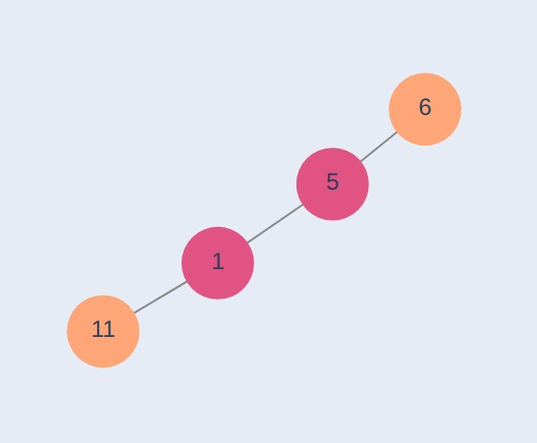
Output (contd.)
The end output is any one of the minimum paths possible between the two user defined nodes.

Slide 9
Progress
We have the clingo code to minimize the path between two given nodes
1
We have completed the input and output GUI interface using python.
2
We have almost completed interfacing clingo with the python GUI.
3

Slide 10
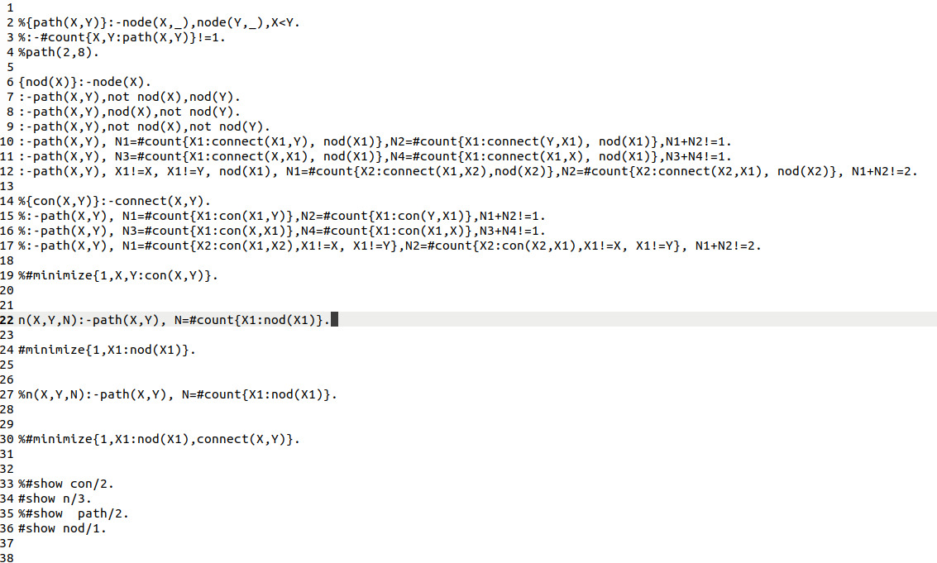
Clingo Code

Slide 11
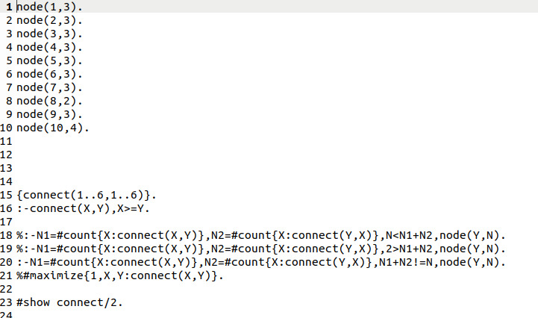

Slide 12
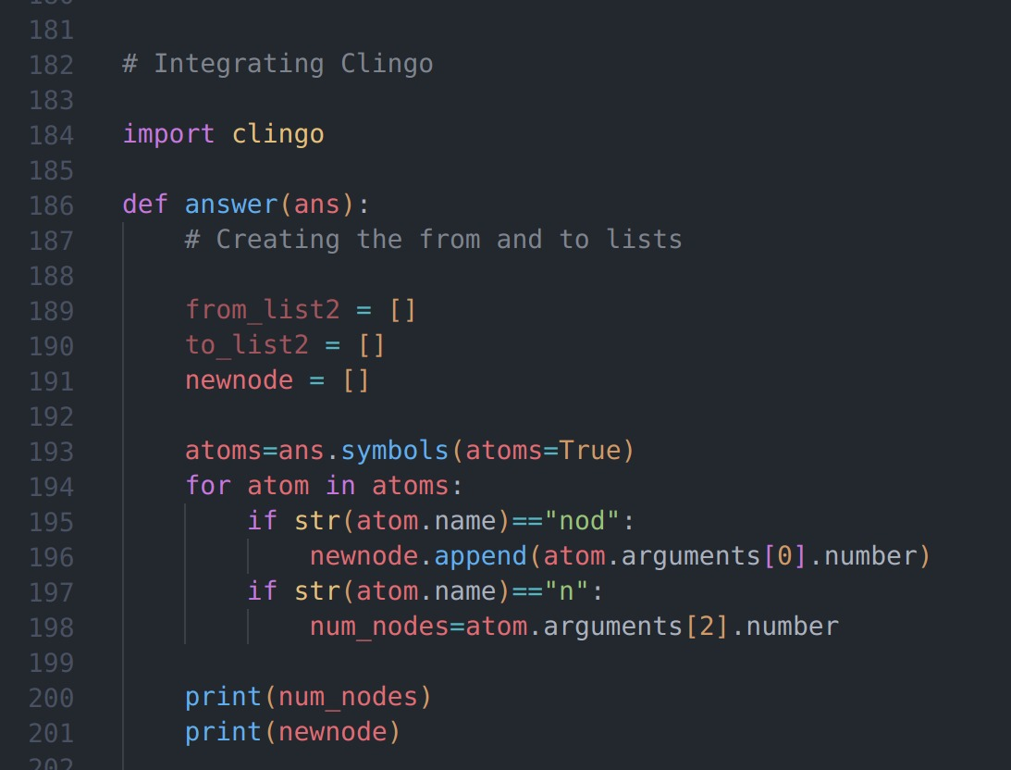
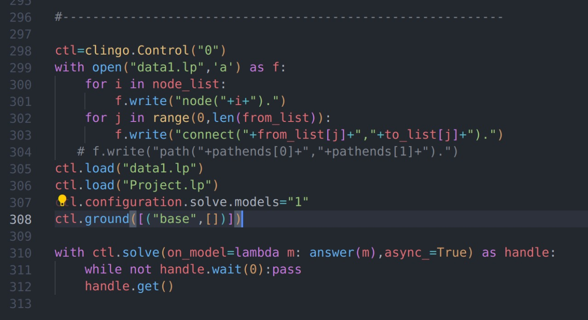
Integrating Clingo with Python

Slide 13
Progress After last Presentation
Clingo code for finding the smallest path between any two nodes in a network were written. Here the clingo code has been now modified to find the least weighted path between any two user defined nodes in the network topology (The weights for each edge /connection is user defined.
Integrating Python GUI with Clingo was not done last time. Now integrating Clingo with python has been implemented successfully .

Slide 14
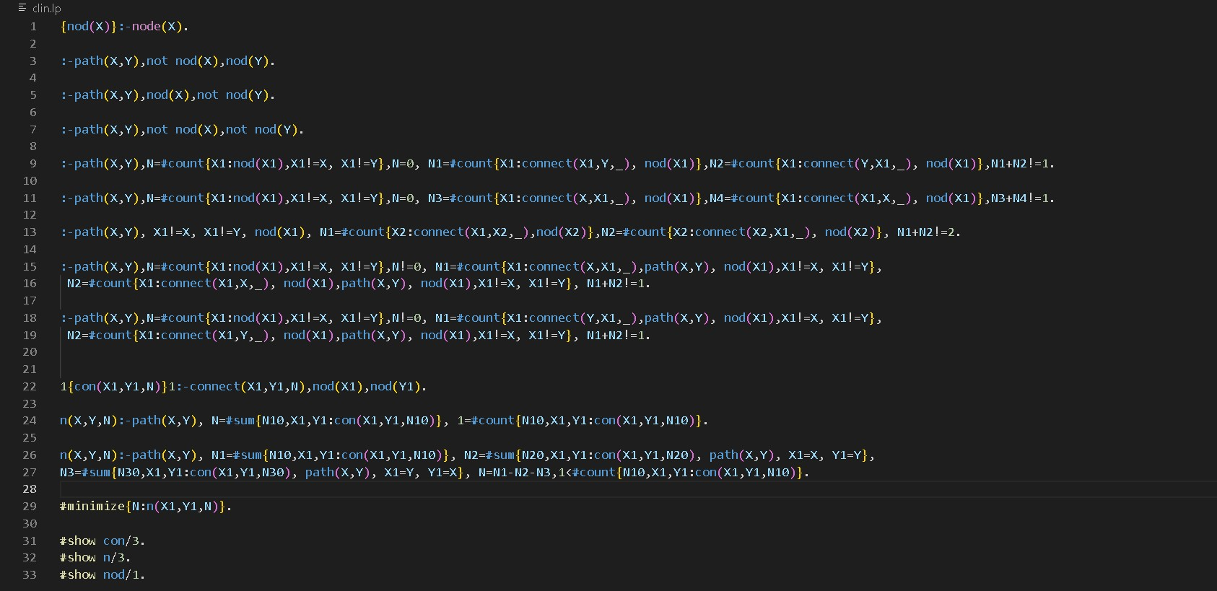
Clingo Code

Slide 15
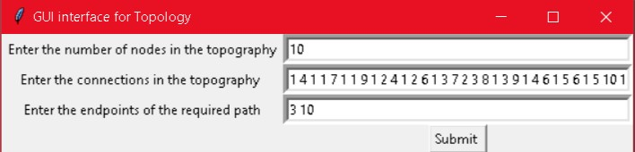
Sample Input
The first box specifies number of nodes in the network.
The second box takes each connections and their weights
(eg:1 4 1 1 7 1 …. means nodes 1 and 4 connected with weight 1, nodes1 and 7 connected with weights 1 and so on)
The third box takes the nodes between which you need to find the least weighted path.

Slide 16
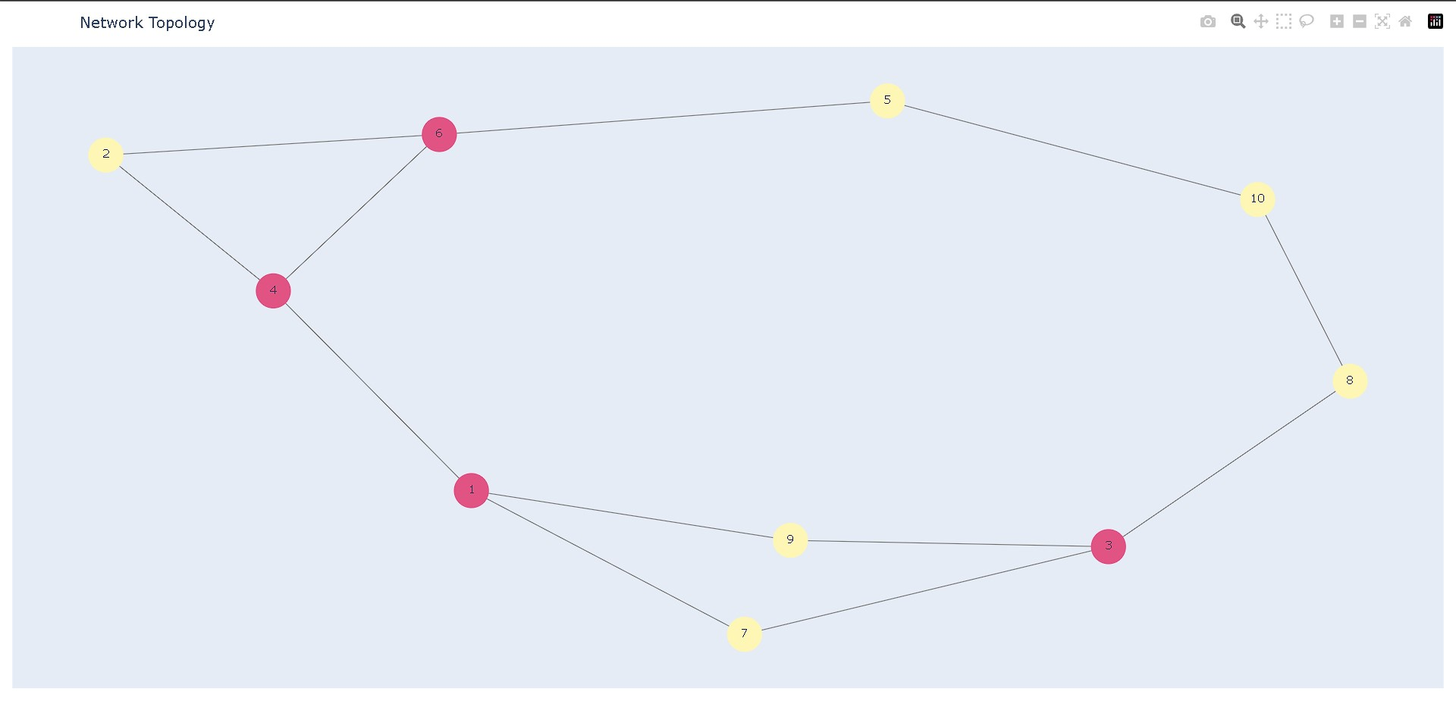
Sample Output
Outputs the network topology created by the user with all nodes and connections.

Slide 17
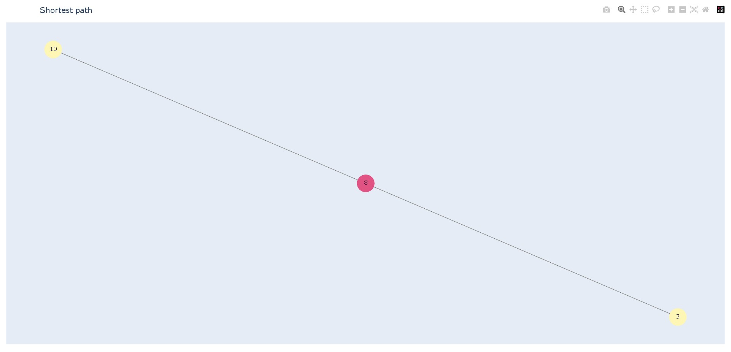
Output(contd.)
The end output is the least weighing path possible between the two user defined nodes.

Slide 18
Thank You

